Slide 1
Data Protection, Privacy and Freedom of Information
Dr. Aftab Maroof
NUCES, Islamabad Campus
(Lecture Slides Week # 10)

Slide 2
Data Protection, Privacy and Freedom of Information
Public Concern:
Very large amount of data about individuals being collected and stored in computers
Used for purposes that were not only different from those intended when data collected, but also unacceptable
Unauthorized people could access such data
Individual’s Movement Tracking through credit card details
Data may be out of date, incomplete or incorrect
Incorrect Credit Rating due to incorrect data
These concerns surfaced in the 1970s, particularly strong in the UK and the rest of Europe
UK - Data Protection Act, 1984 and then 1998
Data Protection Purposes:
To protect individuals from the use of inaccurate personal information or information that is incomplete or irrelevant
To protect individuals from the use of personal information by unauthorized persons
To protect individuals from the use of personal information for purposes other than that for which it was collected

Slide 3
Data Protection, Privacy and Freedom of Information
Individual Privacy:
Most people feel that they are entitled to keep personal information private
Bank balance, Medical history, CGPA . . .
Personal correspondence, phone calls, SMS messages, photos taken on private occasions
While most people accept individual’s right to privacy, they don’t want to extend the same to governments / institutions
Governments are traditionally reluctant to release information to their citizens even when no security issue exists
This lead to Freedom of Information Legislation

Slide 4
Data Protection, Privacy and Freedom of Information
Data Protection Principles:
Personal data should be processed fairly and lawfully and with the consent of individual (court may overrule)
Personal data should be obtained only for one or more specified and lawful purposes and should not be further processed in any manner incompatible with that purpose / those purposes
Personal data should be adequate, relevant and not excessive in relation to the purpose or purposes for which they are processed
Personal data should be accurate and , where necessary, kept up to date
Personal data processed for any purpose or purposes shall not be kept for longer than is necessary for that purpose or those purposes

Slide 5
Data Protection, Privacy and Freedom of Information
Data Protection Principles:
Personal data should be processed in accordance with the rights of individual
Appropriate technical and organizational measures should be taken against unauthorized or unlawful processing of personal data and against accidental loss or destruction of data
Most substantial operational impact
Implies access control, backup procedures, integrity checks
Personal data should not be transferred to a company or territory outside the original jurisdiction unless adequate level of protection is ensured
Protecting data transfer to countries where no limitation/ protection
Website data – No protection implied if no data protection law in original source country

Slide 6
FOI in Pakistan
Prior to 2010 the 1973 Constitution of Pakistan did not explicitly recognize citizens’ right to access information as it states that "every citizen shall have the right to freedom of speech and expression, and there shall be freedom of the press, subject to any reasonable restrictions imposed by law”.
As Pakistan signed the International Covenant for Civil and Political rights (ICCR), it was required to incorporate a right to information in its legal structure. The right to access information added to the Constitution by the 18th Amendment, which declared that under Article 19-A
“Every citizen shall have the right to have access to information in all matters of public importance subject to regulation and reasonable restrictions imposed by law.” Both federal and provincial governments issued various laws in order to allow Pakistani citizens to exercise their right to access public data.

Slide 7
FOI at Federal Level
The FOI Ordinance authorizes Pakistani citizens to gain access to data held by the national government. The Ordinance only pertains to the Federal Government organizations and does not apply to any provincial governments or private entities funded by the national government.
The Freedom of Information Rules 2004 details the procedure through which the governmental data can be requested: applicants must pay a fee and enclose the purpose of their inquiry by providing specific reasons as to why they need the information. If the requested information is not provided in 21 days, the applicant may file a complaint to the head of the public body.
Only access to public records is permitted, which excludes such documents as notes, timings of meetings, personal bank account data, classified information, data pertaining to national security, etc.

Slide 8
FOI at Provincial Level
The FOI Ordinance of 2004 laid the basis for the following two provincial laws:
The Baluchistan Freedom of Information Act in 2005 and Sindh Freedom of Information Act in 2006.
In addition, the Khyber Pakhtunkhwa Right to Information Act (KPK RTI) and the Punjab Transparency and Right to Information Ordinance were both passed in 2013.
The KPK RTI Act covers not only official governmental bodies, but also non-governmental entities that are funded by the government (for example, locally funded public service organizations).
The Punjab RTI Act can be used not only by the citizens of Pakistan, but also by legal bodies that are registered within Pakistan territorial borders.
Sindh repealed and replaced its 2006 Act a decade later with the Sindh Transparency and Right to Information Act, 2016.

Slide 9
Data Protection, Privacy and Freedom of Information
Privacy:
Organizations can monitor and record communications without the user consent provided this is done for one of the following purposes:
To establish facts e.g. date when order placed
To ensure that organization’s regulations and procedures are being complied with
To ascertain standards which are or ought be to be achieved
To prevent or detect crime
To investigate or detect unauthorized use of the system (s)
To ensure effective operation of the system e.g. by detecting viruses or denial of service attacks
To find out whether a communication is a business / private one
To monitor calls to confidential, counseling help lines

Slide 10
Privacy
Introduction
Information disclosures
Data mining

Slide 11
Information Technology Erodes Privacy
Information collection, exchange, combination, and distribution easier than ever means less privacy
Scott McNealy: “You have zero privacy anyway. Get over it.”
We will consider how we leave an “electronic trail” of information behind us and what others can do with this info
Notes:
Scott McNealy is an American businessman. He co-founded computer technology company Sun Microsystems in 1982 along with Vinod Khosla, Bill Joy, and Andy Bechtolsheim. As of September 2012 he is chairman of Wayin, based in Denver.

Slide 13
NON SEQUITUR © 2005 Wiley Ink, Inc. Dist. By UNIVERSAL UCLICK. Reprinted with permission. All rights reserved.
1-13

Slide 14
Privacy
privacy is a human value consisting of four elements
We put these rights into two categories.
The first category includes three rights that an individual can use to fence off personal information seekers;
The second category contains those rights an individual can use to control the amount and
value of personal information given out.
1. Control of external influences:
• Solitude : The right to be alone without disturbances
• Anonymity : The right to have no public personal identity
• Intimacy : The right not to be monitored
2. Control of personal information:
• Reserve : The right to control one’s personal information including the methods
of dissemination of that information

Slide 15
Defining Privacy
Privacy related to notion of access
Access
Physical proximity to a person
Knowledge about a person
Privacy is a “zone of inaccessibility”
Privacy violations are an affront to human dignity
Too much individual privacy can harm society
Where to draw the line?

Slide 16
Harms of Privacy
Cover for illegal or immoral activities
Burden on the nuclear family
Hidden dysfunctional families
Ignored people on society’s fringes
Notes:
A dysfunctional family is a family in which conflict, misbehavior, and often child neglect or abuse on the part of individual parents occur continually and regularly, leading other members to accommodate such actions. Children sometimes grow up in such families with the understanding that such an arrangement is normal.

Slide 17
Benefits of Privacy
Individual growth
Socialization and Individualism → maturity
Individual responsibility
His development as a unique person and separate moral agent
Freedom to be yourself
E.g. in the park with your child.
Intellectual and spiritual growth
Focus on thoughts, be creative without interruption
Development of loving, trusting, caring, intimate relationships
Confiding intense office matters with spouse to blow “off the steam”

Slide 18
Ladder of Privacy
spouse
priest/minister/rabbi
brothers and sisters
parents
children
friends
in-laws
coworkers
neighbors
marketers
employers
government
news media
ex-spouses
potential rivals/enemies

Slide 19
Is There a Natural Right to Privacy?
Privacy rights stem from property rights: “a man’s home is his castle”
a proverbial expression of personal privacy and security
Coercive Acts before American Revolution led to 3rd Amendment to U.S. Constitution
Samuel Warren and Louis Brandeis: People have “the right to be left alone” in their Harvard Law Review article “The Right to Privacy” in 1890.
Judith Jarvis Thomson: “Privacy rights” overlap other rights
Conclusion: Privacy is not a natural right, but it is a prudential right
Notes:
"The Right to Privacy" (4 Harvard L.R. 193 (Dec. 15, 1890)) is a law review article written by Samuel Warren and Louis Brandeis, and published in the 1890Harvard Law Review. It is "one of the most influential essays in the history of American law"^{[1]} and is widely regarded as the first publication in the United States to advocate a right to privacy,^{[2]} articulating that right primarily as a "right to be let alone".^{[3]}
In conclusion, philosophers disagree whether there is a natural right to privacy, but most commentators can agree that privacy is a prudential right. That means rational agents would agree to recognize some privacy rights, because granting these rights is to the benefit of society.

Slide 20
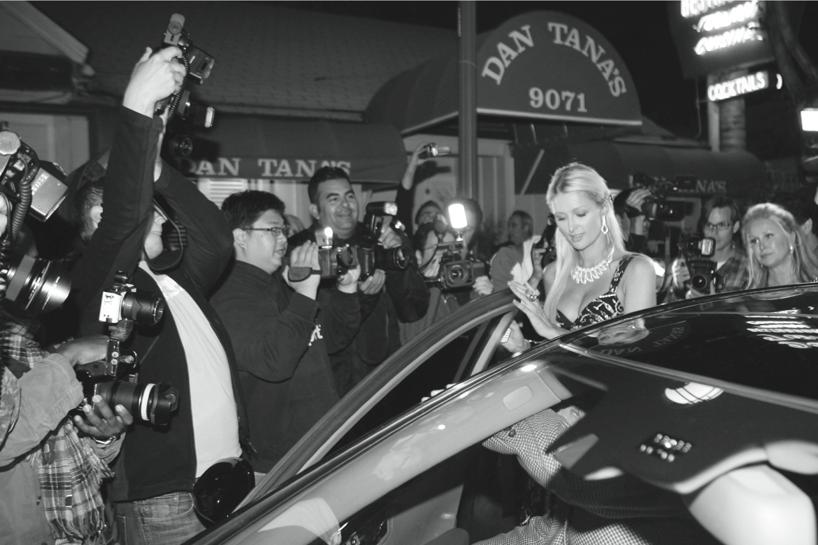
Do People Have the Right to Be Left Alone?
PhamousFotos / Splash News/Newscom

Slide 21
Privacy and Trust
Perhaps modern life is actually more private than life centuries ago
Most people don’t live with extended families
Automobile allows us to travel alone
Television v. public entertainment
Challenge: we now live among strangers
Remedy: establishing reputations
Ordeal, such as lie detector test or drug test
Credential, such as driver’s license, key, ID card, college degree
Establishing reputation is done at the cost of reducing privacy

Slide 22
Case Study: Secret Monitoring
Sullivans have a baby girl
Both work; they are concerned about performance of full-time nanny
Purchase program that allows monitoring through laptop’s camera placed in family room
They do not inform nanny she is being monitored

Slide 23
Analysis
Sullivans are wrong to secretly monitor how well their nanny takes care of their baby
Morally acceptable options
Conduct more comprehensive interview of nanny
More thoroughly check nanny’s references
Spend a day or two at home observing nanny from a distance
Be up-front with nanny about desire to install and use surveillance software on laptop

Slide 24
5.3 Information Disclosures

Slide 25
Public Records
Public record: information about an incident or action reported to a government agency for purpose of informing the public
Examples: birth certificates, marriage licenses, motor vehicle records, criminal records, deeds to property
Computerized databases and Internet have made public records much easier to access

Slide 26
Records Held by Private Organizations
Credit card purchases
Purchases made with loyalty cards.
Posts to social network sites

Slide 27
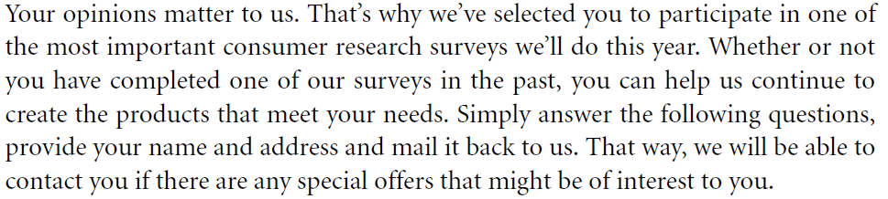
Product preference survey by PnG

Slide 28
Data Gathering and Privacy Implications
Facebook tags
Enhanced 911 services
Rewards or loyalty programs
Body scanners
RFID tags
Implanted chips
OnStar
Automobile “black boxes”
Medical records
Digital video recorders
Cookies and flash cookies

Slide 29
Facebook Tags
Tag: Label identifying a person in a photo
Facebook allows users to tag people who are on their list of friends
About 100 million tags added per day in Facebook
Facebook uses facial recognition to suggest name of friend appearing in photo
Complaint by EPIC – Electronic Privacy Information Center (EPIC)
Does this feature increase risk of improper tagging?

Slide 30
Enhanced 911 Services
Cell phone providers in United States required to track locations of active cell phones to within 100 meters
Allows emergency response teams to reach people in distress
Identify the location of active cell users
Is signal strength is weak, coverage to be improved
What if this information is sold or shared?
Your boss becomes suspicious about the consecutive Friday you are ill on.

Slide 31
Rewards or Loyalty Programs
Shoppers who belong to store’s rewards program can save money on many of their purchases
Computers use information about buying habits to provide personalized service
ShopRite computerized shopping carts with pop-up ads
Do card users pay less, or do non-users get overcharged?
Some give phony information or exchange cards regularly with other customers.

Slide 32
Body Scanners
Some department stores have 3-D body scanners
Computer can use this information to recommend clothes
Scans can also be used to produce custom-made clothing

Slide 33
Body Scanner Takes Measurements
AP Photo/Richard Drew

Slide 34
RFID Tags
RFID: Radio frequency identification
An RFID tag is a tiny wireless transmitter
Manufacturers are replacing bar codes with RFID tags
Contain more information
Can be scanned more easily
If tag cannot be removed or disabled, it becomes a tracking device
Notes:
QR codes for Funerary Use by Japanese company to locate the virtual site of the tombstone

Slide 35
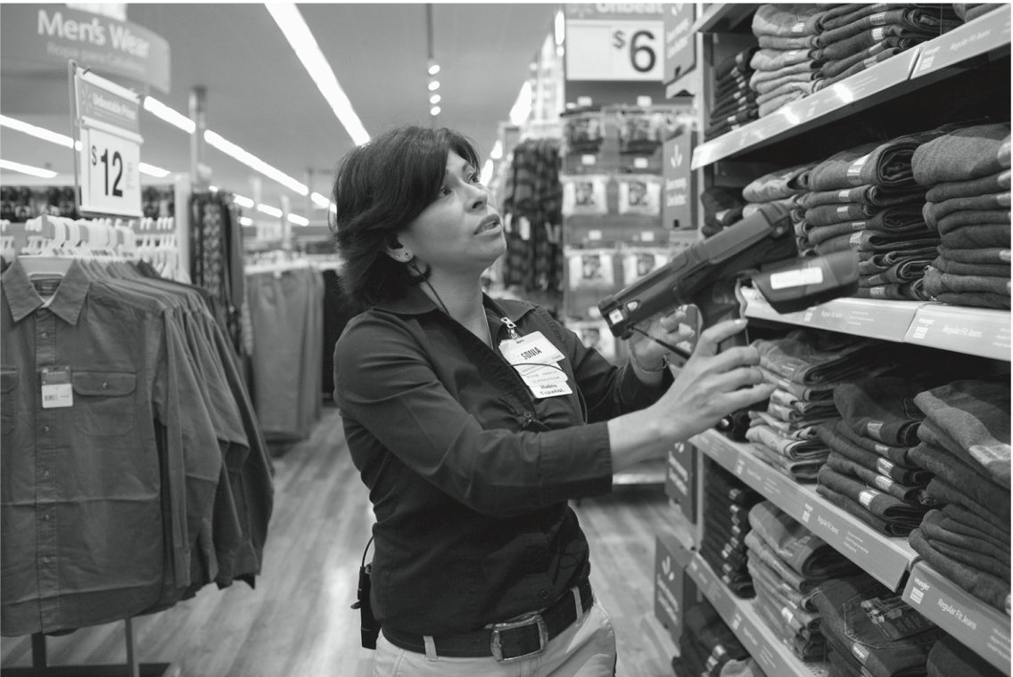
RFID Tags Speed Inventory Process
© Marc F. Henning / Alamy

Slide 36
Implanted Chips
Taiwan: Every domesticated dog must have an implanted microchip
Size of a grain of rice; implanted into ear
Chip contains name, address of owner
Allows lost dogs to be returned to owners
RFID tags approved for use in humans
Can be used to store medical information
Can be used as a “debit card”

Slide 37
OnStar
OnStar manufactures communication system incorporated into rear-view mirror
Emergency, security, navigation, and diagnostics services provided subscribers
Two-way communication and GPS
Automatic communication when airbags deploy
Service center can even disable gas pedal
OnStar claims:
It does not continuously monitor the vehicles
Does not pass on info to law enforcing agencies
Representatives cannot listen to conversation without alerting the occupants of the vehicle

Slide 38
Automobile “Black Boxes”
Modern automobiles come equipped with a “black box”
A microprocessor attached to car’s airbag
Maintains data for five seconds:
Speed of car
Amount of pressure being put on brake pedal
Seat belt status
After an accident, investigators can retrieve and gather information from “black box”

Slide 39
Medical Records
Advantages of changing from paper-based to electronic medical records
Quicker and cheaper for information to be shared among caregivers
Lower medical costs
Improve quality of medical care
Once information in a database, more difficult to control how it is disseminated
Employer may pass over the job candidate who is more expensive to insure.
Discrimination against the woman who has been completely treated for drug addiction

Slide 40
Digital Video Recorders
TiVo service allows subscribers to record programs and watch them later
TiVo collects detailed information about viewing habits of its subscribers
Data collected second by second, making it valuable to advertisers and others interested in knowing viewing habits

Slide 41
Cookies
Cookie: File placed on computer’s hard drive by a Web server
Contains information about visits to a Web site
Allows Web sites to provide personalized services
Put on hard drive without user’s permission
You can set Web browser to alert you to new cookies or to block cookies entirely

Slide 42
Flash Cookies
Flash cookie: File placed on your computer’s hard drive by a Web server running the Adobe Flash Player
Flash cookie can hold 25 times as much information as a browser cookie
Flash cookies not controlled by browser’s privacy controls
Some Web sites use flash cookies as a way of backing up browser cookies. If you delete browser cookie, it can be “respawned” from the flash cookie
Half of 100 most popular Web sites use flash cookies

Slide 43
5.4 Data Mining

Slide 44
Data Mining
data mining is used to discover patterns and relationships in the data/records in one or more databases in order to help make better business decisions by discovering patterns or relationships
Data mining can help spot sales trends, develop smarter marketing campaigns, and accurately predict customer loyalty.
Can be used to profile individuals
Allows companies to build more personal relationships with customers

Slide 45
Google’s Personalized Search
Secondary use: Information collected for one purpose use for another purpose
Google keeps track of your search queries and Web pages you have visited
It uses this information to infer your interests and determine which pages to return
Example: “bass” could refer to fishing or music
Also used by retailers for direct marketing
https://www.youtube.com/watch?v=B8ofWFx525s

Slide 46
Collaborative Filtering
collaborative filtering is a method of making automatic predictions (filtering) about the interests of a user by collecting preferences or taste information from many users (collaborating). It is a form of data mining
Analyze information about preferences of large number of people to predict what one person may prefer
Explicit method: people rank preferences
Implicit method: keep track of purchases
Used by online retailers and movie sites

Slide 47
Ownership of Transaction Information
Who controls transaction information?
Buyer?
Seller?
Both?
Opt-in: Consumer must explicitly give permission before the organization can share info
Opt-out: Organization can share info until consumer explicitly forbid it
Opt-in is a barrier for new businesses, so direct marketing organizations prefer opt-out

Slide 48
Credit Reports
Example of how information about customers can itself become a commodity
Credit bureaus
Keep track of an individual’s assets, debts, and history of paying bills and repaying loans
Sell credit reports to banks, credit card companies, and other potential lenders
System gives you more choices in where to borrow money
Poor credit can hurt employment prospects

Slide 49
Microtargeting
Since 2004, direct marketing based on data-mining an essential part of US Presidential campaigns.
Political campaigns determine voters most likely to support particular candidates
Voter registration, Voting frequency, Consumer data, GIS data
Target direct mailings, emails, text messages, home visits to most likely supporters

Slide 50
Connecting the Dots
Government agency managing toll booths keeps data:
<transponder number> <date> <time> <location> <charge>
Keeps the identity private
But if charged directly to credit card company, it can be traced and sold to banks interested in soliciting automobile loan applications.

Slide 51
Marketplace: Households
Lotus Development Corporation developed CD with information on 120 million Americans
Planned to sell CD to small businesses that wanted to create mailing lists based on various criteria, such as household income
More than 30,000 consumers complained to Lotus about invasion of privacy
Lotus dropped plans to sell CD

Slide 52
Facebook Beacon
Fandango, eBay, and 42 other online businesses paid Facebook to do “word of mouth” advertising
Facebook users surprised to learn information about their purchases was shared with friends
Beacon was based on an opt-out policy
Beacon strongly criticized by various groups, like MoveOn.org who created on-line group calling for Beacon to become opt-in from users.
Facebook switched to an opt-in policy regarding Beacon

Slide 53
John Lane bought 14K White Gold 1/5 ct Diamond Eternity Flower Ring from overstock.com

Slide 54
Netflix Prize
On 2006, Netflix offered $1 million prize to any group that could come up with a significantly (at least 10%) better algorithm for predicting user ratings
Released more than 100 million movie ratings from a half million customers
Stripped ratings of private information
Four attributes: subscriber, movie, date of grade and grade
Researchers demonstrated that ratings not truly anonymous if a little more information from individuals was available
U.S. Federal Trade Commission complaint and lawsuit
Netflix canceled sequel to Netflix Prize
Notes:
Cinematch

Slide 55
Social Network Analysis
Data mining now incorporating information collected from social networks
Examples
Cell phone companies in India identify “influencers”
Police predict locations of big parties
Banks evaluate the riskiness of loans

Slide 56
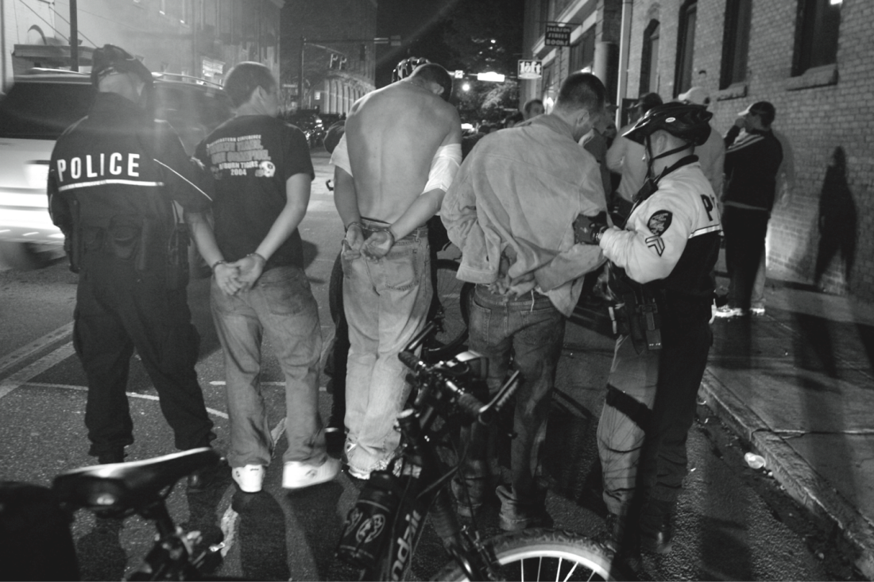
Police Monitor Facebook and Twitter to Identify Locations of Big Parties
© Allen Sullivan/ZUMA Press/Newscom

Slide 57
Data Protection, Privacy and Freedom of Information
Freedom of Information:
Primary Purpose:
To provide clear rights of access to information held by bodies in the public sector
Any member of the public can apply for access to such information
Legislation may provide enforcement mechanism if the information is not made available
Freedom of Information Laws may conflict with Data Protection Laws
Documents including personal information
Relevant Legislation in Pakistan:
PTA Act, 1996
Freedom of Information Ordinance, 2002
Electronic Data Protection and Safety Act, 2005 (Draft)
Right to Information Act (2013)

